Slide 1
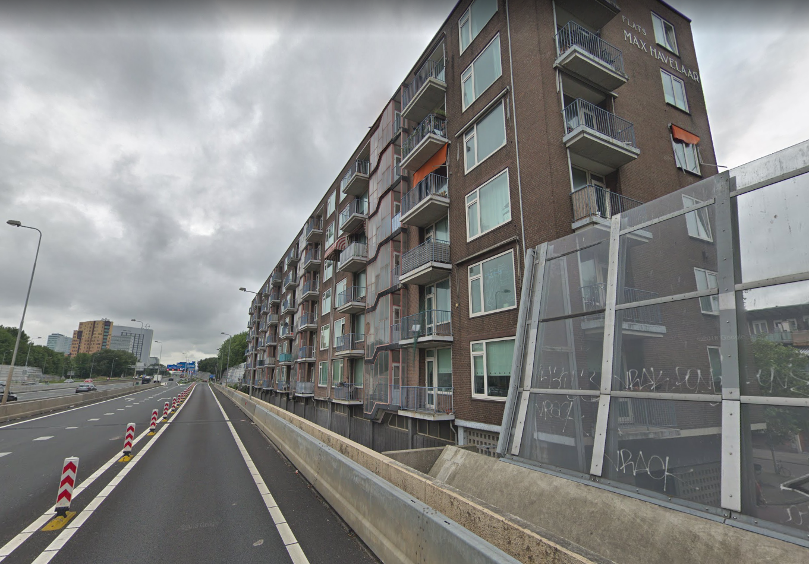
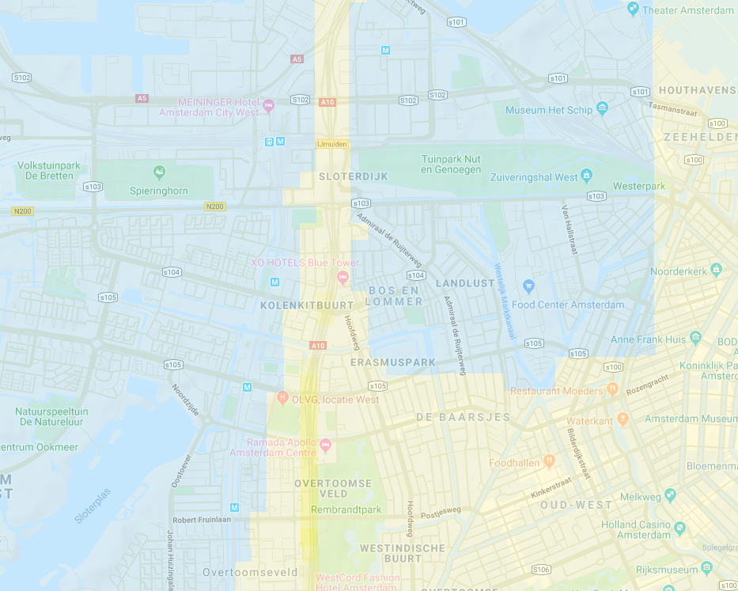

Slide 2

SOAP (SOcialAirPollution)
Team: 10
Challenge: Air pollution

Slide 3
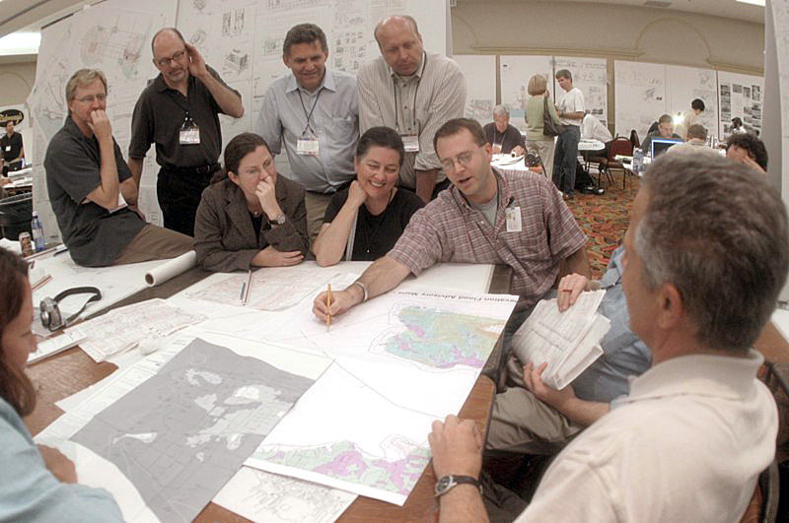

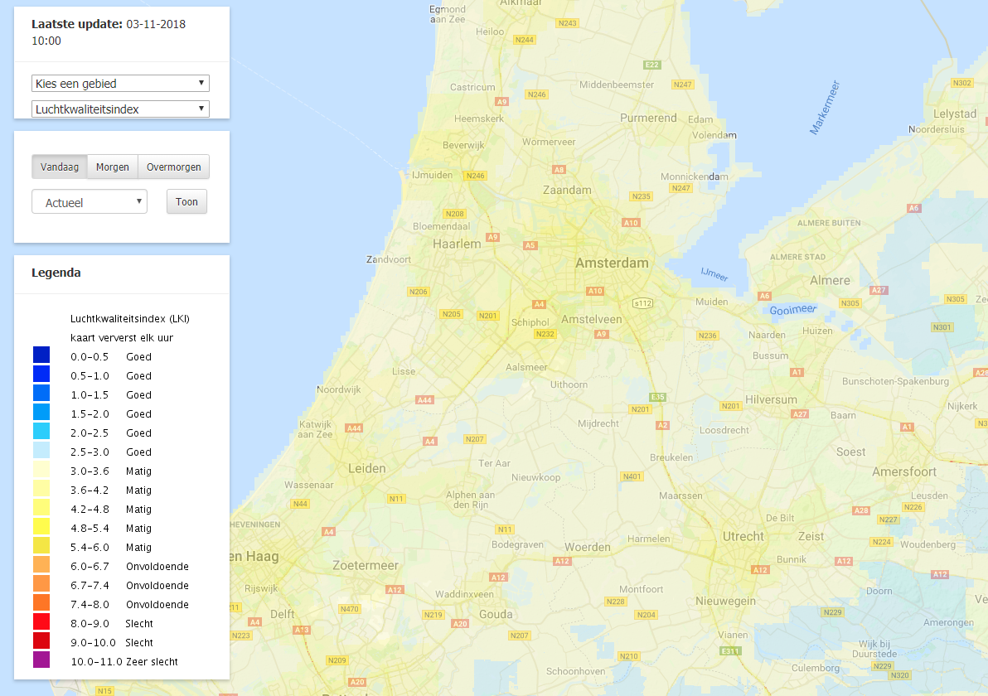
?
Open tool with integrated datasets on economic or social status
Bottleneck

Slide 4
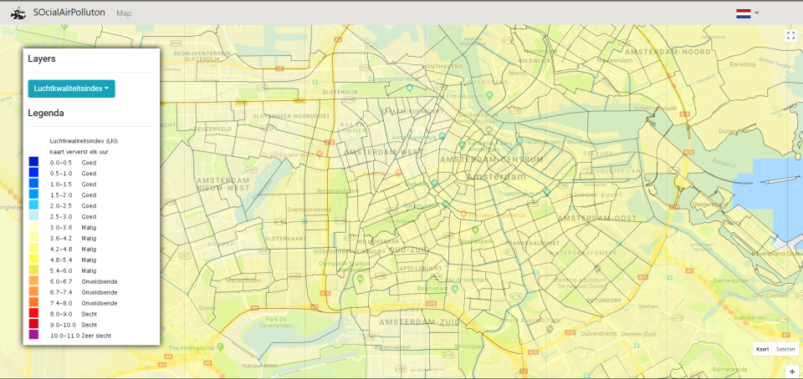
Our product

Slide 5



Consultancy firms
Municipalities
Our customers
Health insurance providers

Slide 6

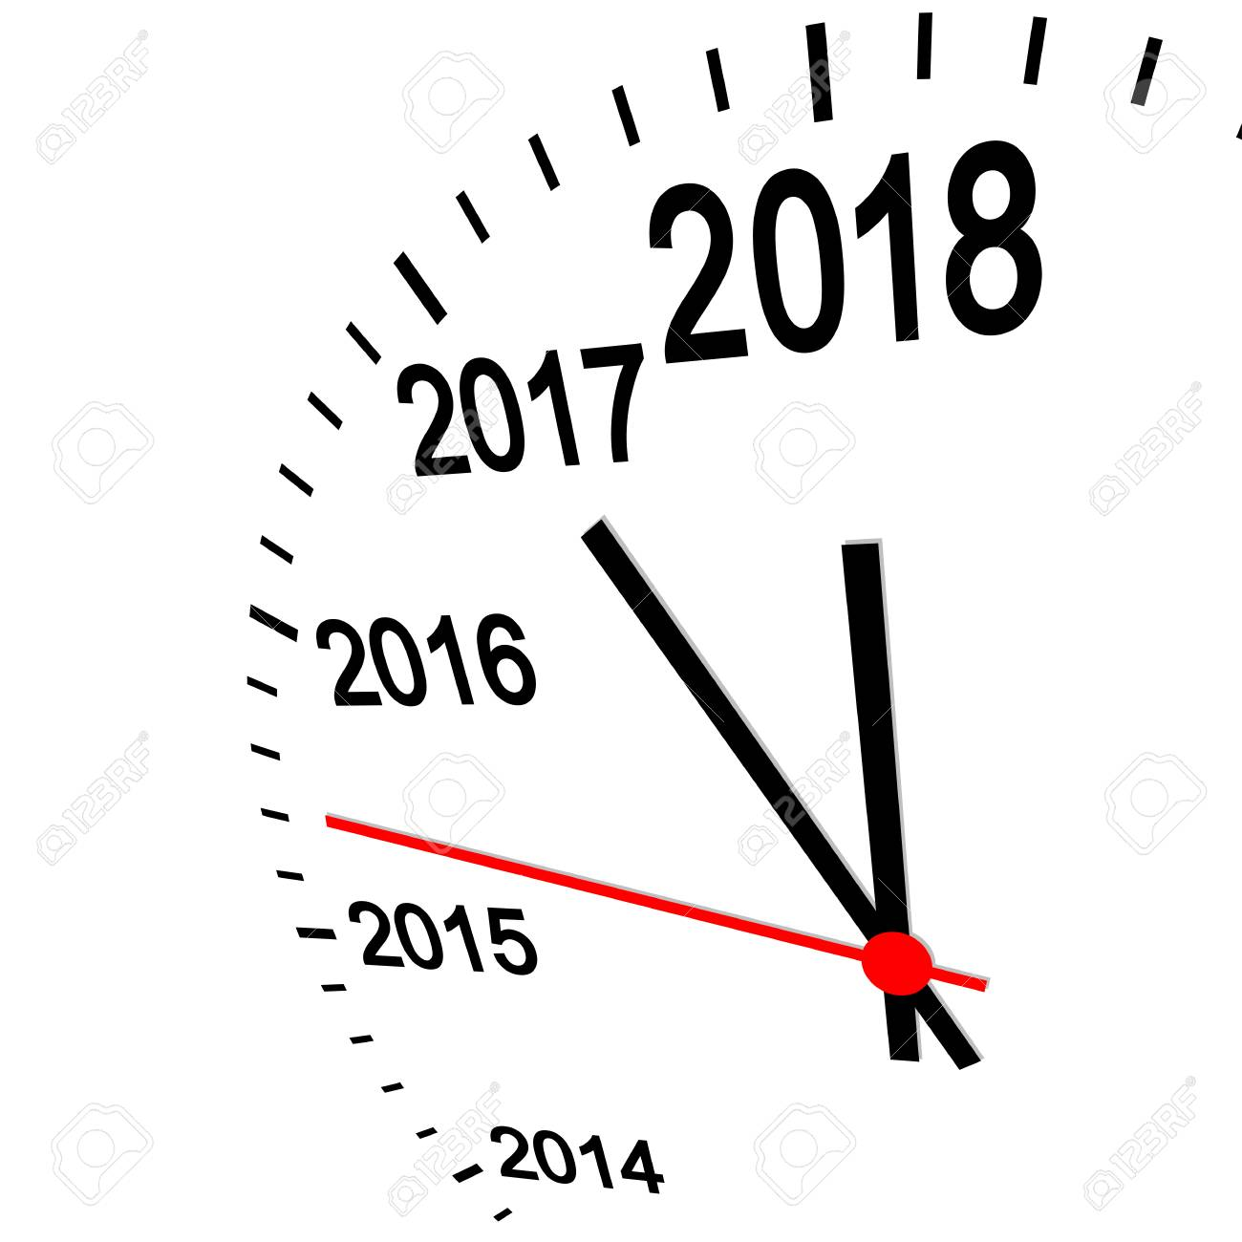
Future development
Open tool with integrated datasets on economic or social status

Slide 7


Conclusion
?
Open tool with integrated datasets on economic or social status

